Slide 1
6CS003 – Graphics and Artificial Intelligence
Week 2
Transformation of Objects
(based on Matrices multiplication)

Slide 2
Overview
Matrix Multiplication
What is a Transformation
Translation
Scaling
Rotating
What about 3D Objects
Task 2

Slide 3
MATRIX MULTIPLICATION

Slide 4
Basic Matrix Multiplication 1
Basically its about multiplying rows and columns i.e.
When matrices are places like this it means they are to be multiplied
w x
y z
a b
c d
(a*w)+(b*y) (a*x)+(b*z)
(c*w)+(d*y) (c*x)+(d*z)
=

Slide 5
Basic Matrix Multiplication 2
Matrices don’t have to be the same size to multiply i.e.
Resulting matrix size is the number of rows of matrix 1 and the number of columns of matrix 2
a b
w x
y z
(a*w)+(b*y) (a*x)+(b*z)
=

Slide 6
Basic Matrix Multiplication 3
a
b
c
m q t
n r u
p s v
=
(a*m)+(d*n)+(g*p) (a*q)+(d*r)+(g*s) (a*t)+(d*u)+(g*v)
(b*m)+(e*n)+(h*p) (b*q)+(e*r)+(h*s) ?*? + ?*? + ?*?
(c*m)+(f*n)+(i*p) ?*? + ?*? + ?*? ?*? + ?*? + ?*?

Slide 7
Vector
Vector is a matrix with only 1 row or column.
E.g.
X
Y
Z

Slide 8
WHAT IS A TRANSFORMATION

Slide 9
Why Use Matrices for Transformations?
Main advantage of using the matrix representation of transformations is because we can build up a compound matrix (to perform several operations on an object all at the same time). i.e. scale, rotate and move an object in fewer processing steps.

Slide 10
Why Use Matrices for Transformations?
  we do this by representing each operation i.e. rotate, scale, translate as matrices, then we can multiply these together to achieve the desired transformation.
  then multiply each point on our object (also stored as a matrix by the resulting product matrix instead of multiplying each point on our object by each of the matrices in turn
  thus saving a vast amount of processing time

Slide 11
Homogeneous Co-ordinates
We use co-ordinates which represent the point (x, y) by the column vector
This allows all two-dimensional affine transformation to be represented by 3x3 matrices
X
Y
1
If a 1 a position
If a 0 a direction

Slide 12
TRANSLATION

Slide 13
Translation
Performing a translation on an object, means moving it in the x, y direction. (or combination of)
It is represented in 2D
by a 3 x 3 matrix as shown:
Where t_{x} = movement in x direction
t_{y} = movement in y direction
Notice the underlying Unit matrix
1 0 t_{x}
0 1 t_{y}
0 0 1

Slide 14
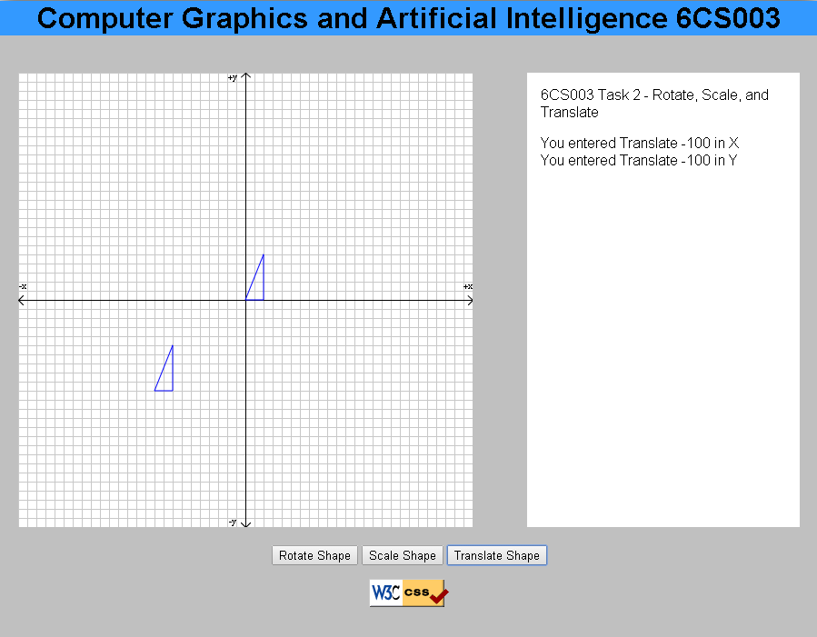
Translation of (-100) in x, (-100) in y
Original Position
Translated Position

Slide 15
ROTATION

Slide 16
Rotation around the origin
Performing a rotation on an object, means rotating it by θ degrees around the origin.
It is represented in 2D
by a 3 x 3 matrix as shown:
Notice the underlying Unit matrix
cos -sin 0
sin cos 0
0 0 1

Slide 17
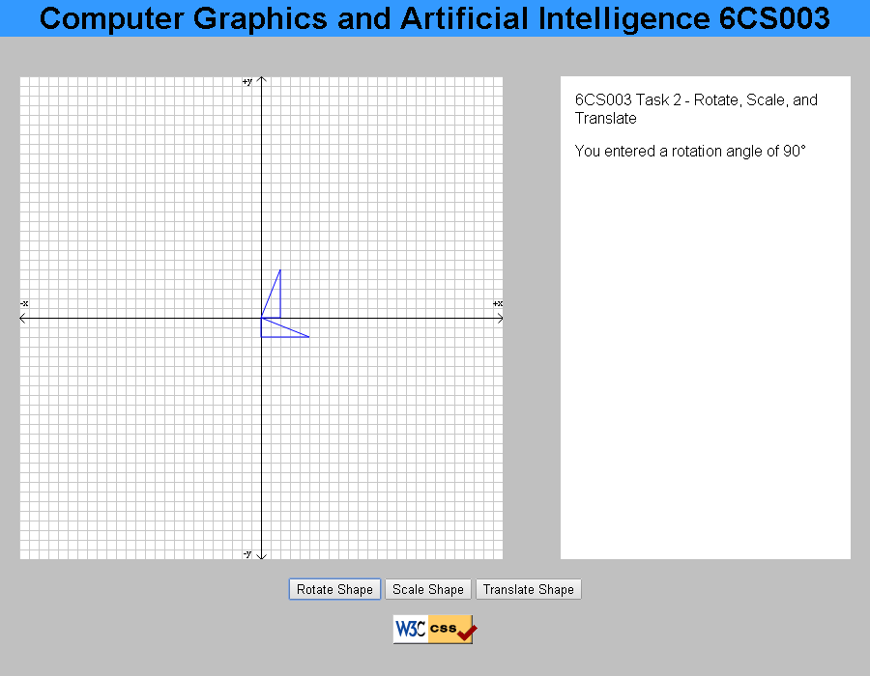
Rotation of 90 degrees
Original Position
Translated Position

Slide 18
SCALING

Slide 19
Scaling
Performing scaling on an object, means affecting its size with respect to the origin
It is represented in 2D
by a 3 x 3 matrix as shown:
Where s_{x} = scaling for x
s_{y} = scaling for y
Notice the underlying Unit matrix
sx 0 0
0 sy 0
0 0 1

Slide 20
Scaling
An object’s size is changed (in both x and y directions)
The new position of a point is given by:
  x’ = s_{x}.x and y’ = s_{y}.y
  If s_{x} = s_{y} the scaling is homogeneous
  If s_{x} != s_{y} then the object would be deformed
  If s>1 then the object is magnified
  If 0<s<1 the object is reduced
  If s<0 what do you think would happen?

Slide 21
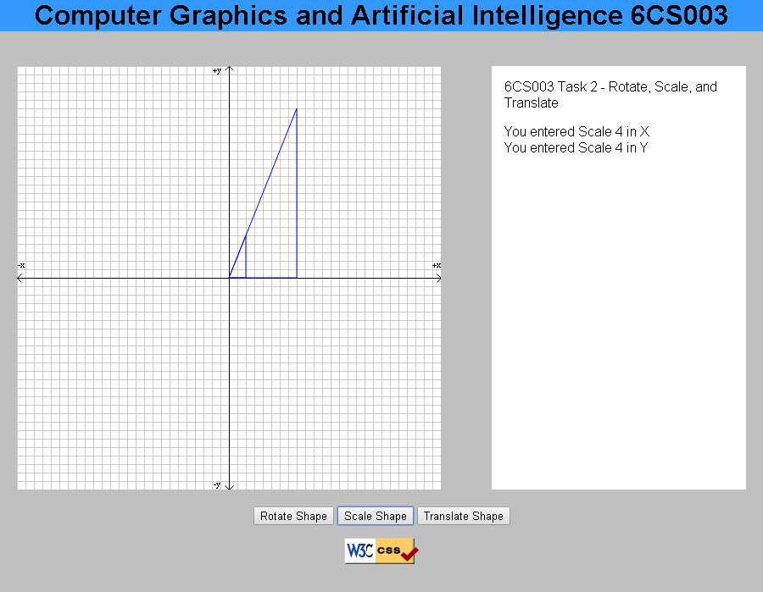
Scaling by 4
Scaled Shape
Original shape

Slide 22
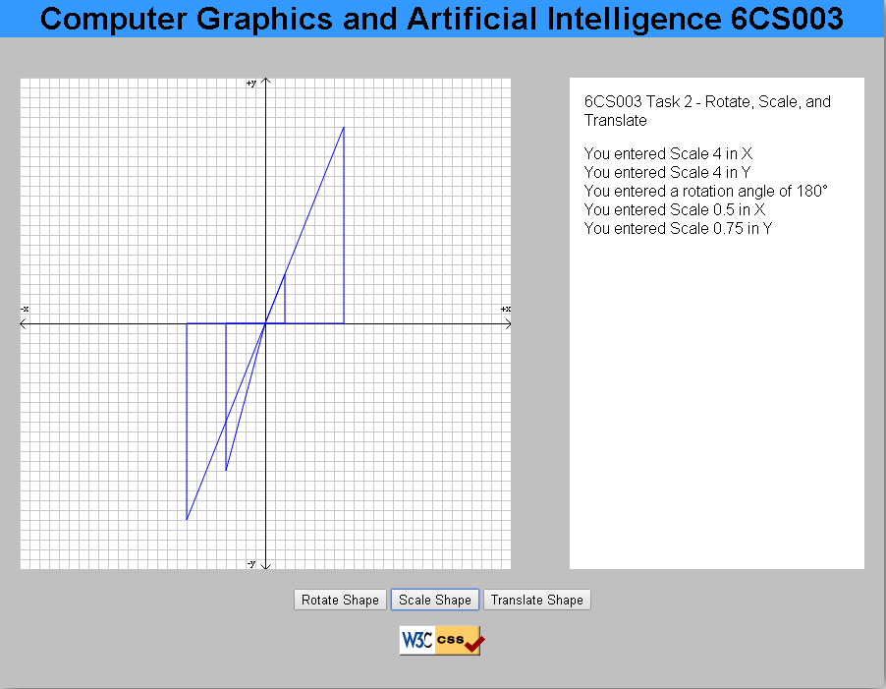
Scaling by 0.5 in x and 0.75 in Y
Scaled Shape
Original shape

Slide 23
COMBINING MATRICES

Slide 24
Example (Rotate about a point)
We want to rotate an object by θ degrees about a point (x,y)
We need to:
  translate the object to the origin (T) so that the invariant point (x,y) becomes the origin (e.g. matrix A),
  rotate about the origin (R) (e.g. matrix B),
  perform the inverse translation (T⁻¹) (e.g. matrix C)

Slide 25
Example (cont.)
We have three matrices that we need to multiply together but can only multiply any two together at one time.
Does the sequence of the multiplication matter?
M = T⁻¹RT
Therefore we must arrange the matrices as CBA to correctly calculate the compound matrix.

Slide 26
C
B
A
1 0 x
0 1 y
0 0 1
cos θ -sin θ 0
sin θ cos θ 0
0 0 1
1 0 -x
0 1 -y
0 0 1
Do this part first.
C = translation
B = rotation
A = inverse translation

Slide 27
CB Resultant Matrix A
cos θ -sin θ x
sin θ cos θ y
0 0 1
1 0 -x
0 1 -y
0 0 1
Now Multiply these

Slide 28
cos θ -sin θ x
sin θ cos θ y
0 0 1
1 0 -x
0 1 -y
0 0 1
x =
cos θ -sin θ x – x.cos θ + y.sin θ
sin θ cos θ y – x.sin θ – y.cos θ
0 0 1

Slide 29
WHAT ABOUT 3D OBJECTS

Slide 30
3D Graphics
Same principles apply to 3D graphics but care is needed with co-ordinates because we have a choice of labelling the axes in two distinct ways: left-handed and right-handed.
y
y
z
x
x
Left Handed
z
RightHanded

Slide 31
3D Transformations
The co-ordinates of the point (x,y,z) represented by the column vector:
Identity or unit matrix:
x
y
z
1
1 0 0 0
0 1 0 0
0 0 1 0
0 0 0 1

Slide 32
3D transformation
Translation by t_{x}, t_{y}, t_{z}:
Scaling by s_{x}, s_{y}, s_{z}:
1 0 0 t_{x}
0 1 0 t_{y}
0 0 1 t_{z}
0 0 0 1
Sx 0 0 0
0 sy 0 0
0 0 sz 0
0 0 0 1

Slide 33
3D Rotation
Need to rotate about an axis rather than about a point
Rotation about x axis
1 0 0 0
0 cosθ -sinθ 0
0 sinθ cosθ 0
0 0 0 1

Slide 34
3D Rotation
Rotation about y axis
Rotation about z axis
cosθ 0 sinθ 0
0 1 0 0
-sinθ 0 cosθ 0
0 0 0 1
cosθ -sin θ 0 0
sinθ cosθ 0 0
0 0 1 0
0 0 0 1

Slide 35
Self Study
Practice on paper multiplying matrices together and do this for your assignment to produce test data to check your results.
Tutorials
http://www.opengl-tutorial.org/beginners-tutorials/tutorial-3-matrices/
http://www.mathwarehouse.com/algebra/matrix/multiply-matrix.php

Slide 36
ASSIGNMENT 1: GRAPHICS
TASK 2 – TRANSFORMATION/MATRICES

Slide 37
In the Workshop
Download from Wolf and save: -
  Task 2.zip
  It contains a HTML file, CSS file and 2 java script files.
  Run the application by running index.html
  Each week you will need to modify the jsToBeUpdated.js file found in the relevant task.
  Once you are happy with your code you need to validate it in JSLint (www.jslint.com). This checks your Java Script for conformance.

Slide 38
Task 2 – Translate, Scale, and Rotate
Here there are three functions which need code:
  transformCoordsX
  transformCoordsY
  matrixMultiply
transformCoords needs code to use a matrix to calculate the new x and y co-ordinates for a point
  matrixMultiply needs to have code to multiply together two 3 x 3 matrices

Slide 39
transformCoords
We need to transform each of the (x,y) pairs of co-ordinates by matrix multiplication.
To do this we can multiply the 3x1 matrix (3 rows and 1 column) by a 3x3 matrix.
X’ X 2 4 20
Y’ = Y * 3 5 30
1 1 0 0 1
x’ = 1st column of 1st matrix multiplied by the 1st row of the 2nd matrix.
y’ = ???

Slide 40
EXPECTED RESULTS

Slide 41
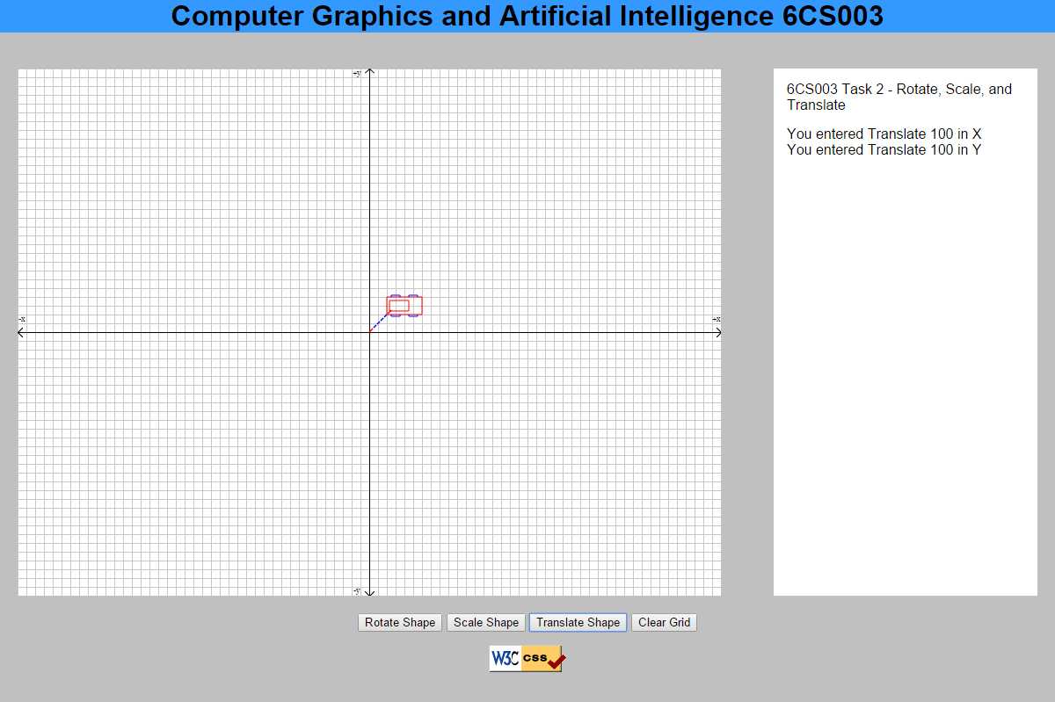
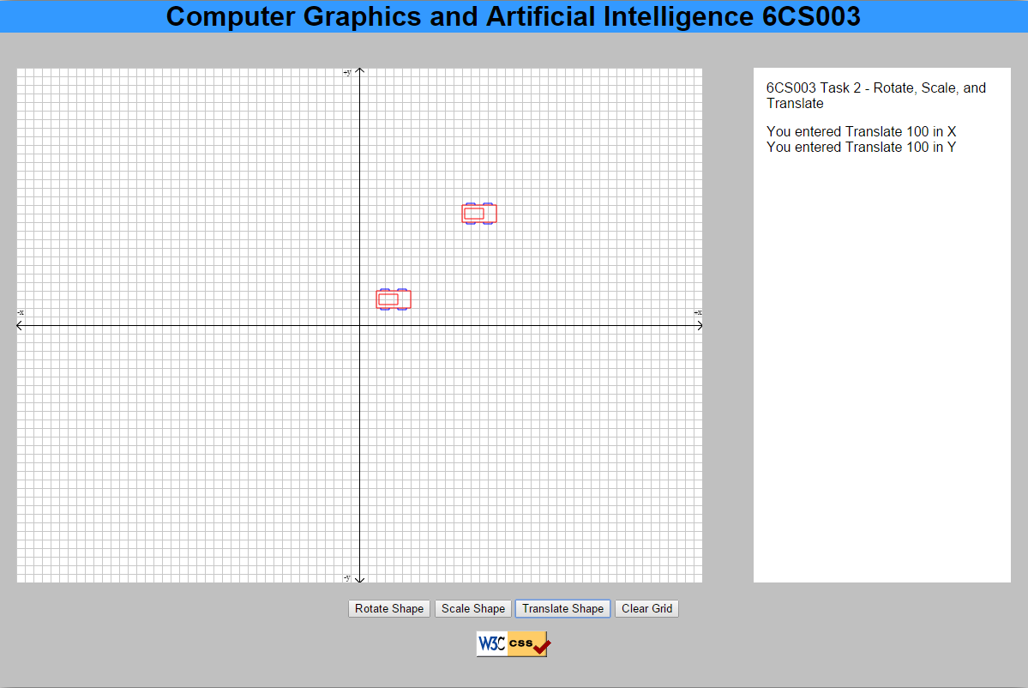
Translate
Before functions are written Desired result

Slide 42
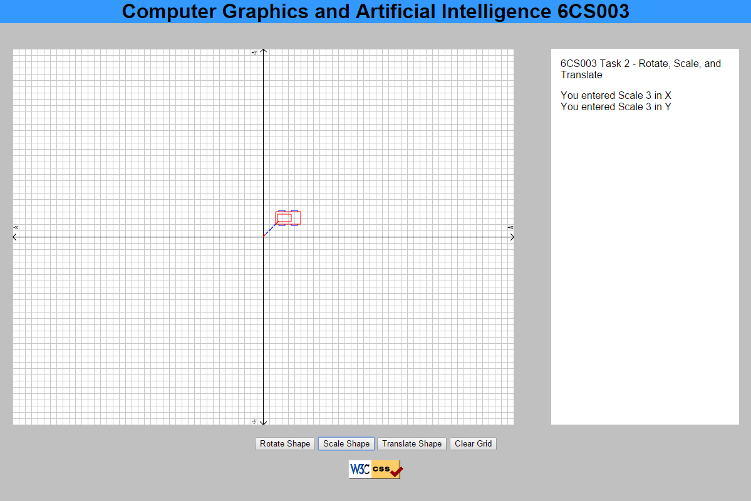
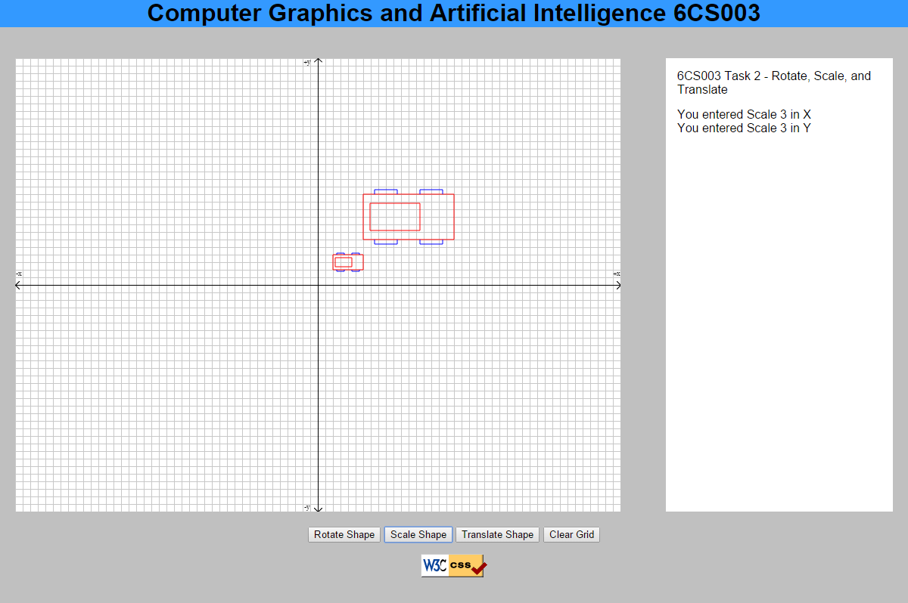
Scale
Before functions are written Desired result

Slide 43
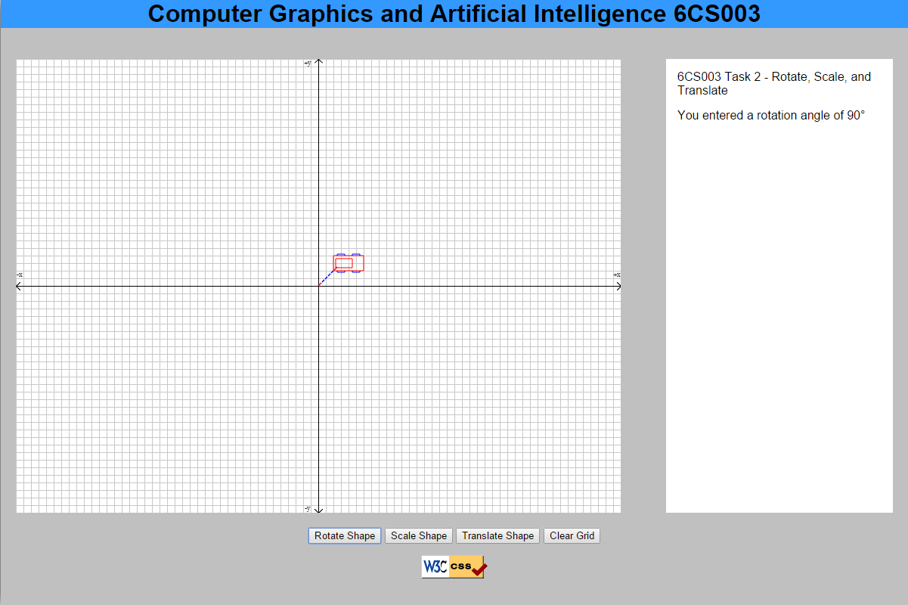
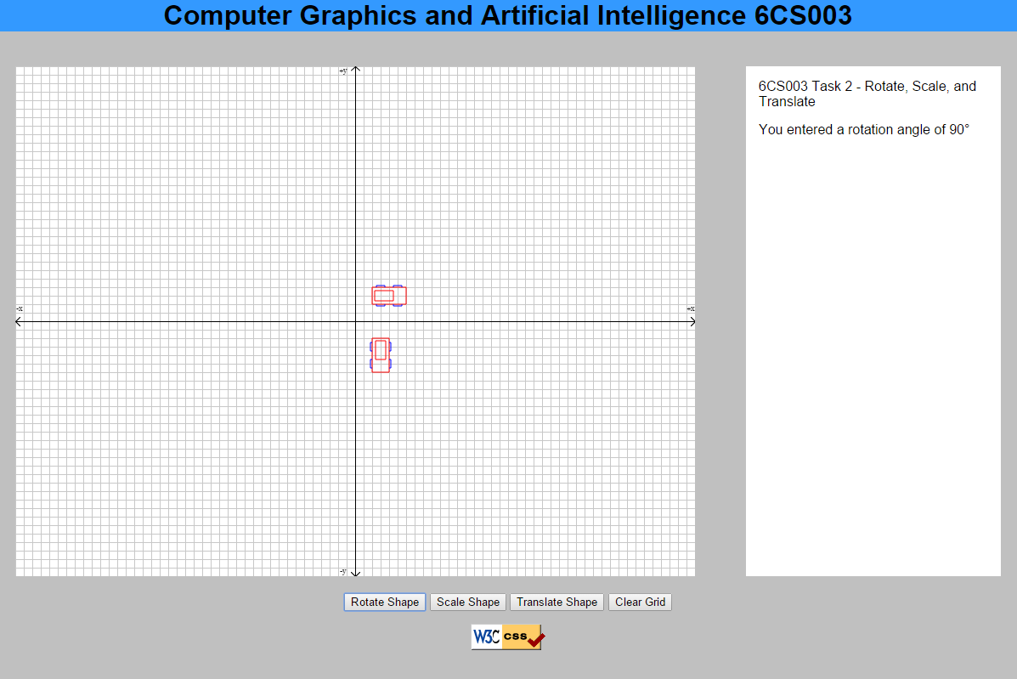
Rotate
Before functions are written Desired result

